Slide 1
Fundamentals of Optimization Constraint Programming
Pham Quang Dung
dungpq@soict.hust.edu.vn
Department of Computer Science

Slide 2
Content
Constraint Satisfaction Optimization Problems
Constraint Propagation
Branching and Backtrack Search
Examples

Slide 3
Constraint Satisfaction Problems
Variables
X = {X₀, X₁, X₂, X₃, X₄}
Domain
X₀, X₁, X₂, X₃, X₄ ∈ {1,2,3,4,5}
Constraints
C₁: X₂ + 3 ≠ X₁
C₂: X₃ ≤ X₄
C₃: X₂ + X₃ = X₀ + 1
C₄: X₄ ≤ 3
C₅: X₁ + X₄ = 7
C₆: X₂ = 1 ⇒ X₄ ≠ 2

Slide 4
Constraint Satisfaction Problems
CSP = (X,D,C), in which:
X = {X₁,...,X_{N}} – set of variables
D = {D(X₁),…, D(X_{N})} – domains of variables
C = {C₁,..,C_{K}} – set of constraints over variables
Denote X(c) – set of variables appearing in the constraint c

Slide 5
Constraint Satisfaction Optimization Problems
COP = (X,D,C,f), in which:
X = {X₁,...,X_{N}} – set of variables
D = {D(X₁),…, D(X_{N})} – domains of variables
C = {C₁,..,C_{K}} – set of constraints over variables
Denote X(c) – set of variables appearing in the constraint c
f: objective function to be optimized

Slide 6
Constraint Programming
A computation paradigm for solving CSP, COP combining
Constraint Propagation: narrow the search space by pruning redundant values from the domains of variables
Branching (backtracking search): split the problem into equivalent sub-problems by
Instantiating some variables with values of its domain
Split the domain of a selected variable into sub-domains

Slide 7
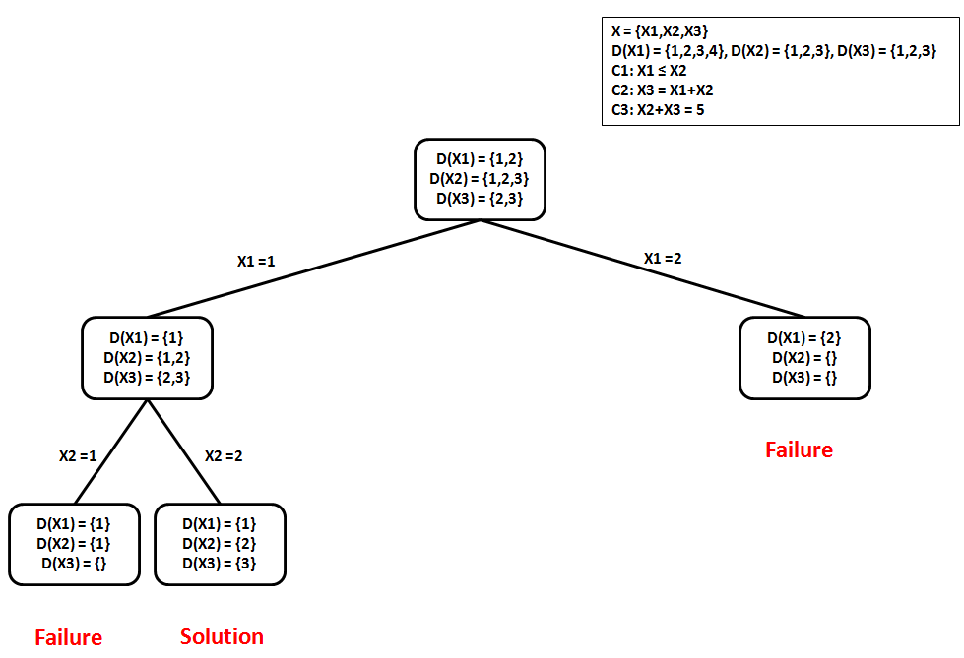
Constraint Programming

Slide 8
Constraint Propagation
Domain consistency (DC)
Given a CSP = (X,D,C), a constraint c ∈ C is called domain consistent if for each variable X_{i} ∈ X(c) and each value v∈D(X_{i}), there exists values for variables of X(c) \ {X_{i}} such that c is satisfied
A CSP is called domain consistent if c is domain consistent for all c ∈ C

Slide 9
Constraint Propagation
DC algorithms aim at pruning redundant values from the domains of variables so that the obtained equivalent CSP is domain consistent

Slide 10
Constraint Propagation
Example: CSP = (X,D,C) in which:
X = {X₁, X₂, X₃, X₄}
D(X₁) = {1,2,3,4}, D(X₂) ={1,2,3,4,5,6,7}, D(X₃) = {2,3,4,5}, D(X₄) = {1,2,3,4,5,6}
C = {c₁,c₂,c₃} với
c₁ ≡ X₁ + X₂ ≥ 5
c₂ ≡ X₁ + X₃ ≥ X₄
c₃ ≡ X₁ + 3 ≥ X₃
🡪 CSP is domain consistent
When branching, consider X₁ = 1, a DC algorithm will transform the given CSP to an equivalent domain consistent CSP¹ having : D¹(X₁) = {1}, D¹(X₂) = {4,5,6,7}, D¹(X₃) = {2,3,4}, D¹(X₄) = {1,2,3,4,5}

Slide 11
Constraint Propagation
A domain consistent CSP does not ensure to have feasible solutions
Example:
X = {X₁,X₂,X₃}
D(X₁) = D(X₂) = D(X₃) = {0,1}
c₁ ≡ X₁ ≠ X₂, c₂ ≡ X₁ ≠ X₃, c₃ ≡ X₂ ≠ X₃
🡪 The CSP is domain consistent but does not have any feasible solution

Slide 12
Constraint Propagation
Algorithm AC3(X,D,C){
Q = {(x,c) | c ∈ C ∧ x ∈X(c)};
while(Q not empty){
select and remove (x,c) from Q;
if ReviseAC3(x,c) then{
if D(x) = {} then
return false;
else
Q = Q ∪{(x’,c’) | c’∈C\{c} ∧ x,x’ ∈X(c’) ∧ x≠ x’}
}
}
return true;
}
Algorithm ReviseAC3(x,c){
CHANGE = false;
for v ∈ D(x) do{
if there does not exists other values
of X(c) \ {x} such that c
is satisfied then{
remove v from D(x);
CHANGE = true;
}
}
return CHANGE;
}

Slide 13
Constraint Propagation
Some constraints, e.g., binary constraints (related 2 variables) 🡪 have efficient DC algorithm
Constraint AllDifferent(X₁,X₂,…,X_{N}), the DC algorithm is efficient based on the matching (Max-Matching) algorithm on bipartite graphs
Nodes on the right-hand side are variables and nodes on the left-hand side are values
For each edge (X_{i}, v), (với v ∈D(X_{i})), if there does not exist a matching of size N containing (X_{i}, v), then v is removed from D(X_{i})

Slide 14
AllDifferent
X = {X₁, X₂, X₃, X₄}
D(X₁) = {1,2,4}, D(X₂) = {1}, D(X₃) = {4}, D(X₄) = {3,4}
X₁
1
X₂
2
X₃
3
X₄
4

Slide 15
AllDifferent
X = {X₁, X₂, X₃, X₄}
D(X₁) = {1,2,4}, D(X₂) = {1}, D(X₃) = {4}, D(X₄) = {3,4}
X₁
1
X₂
2
X₂
2
Edge (X₁, 1)
X₃
3
X₃
3
X₄
4
X₄
4
No matching of size 3 🡪 remove 1 from D(X₁)

Slide 16
AllDifferent
X = {X₁, X₂, X₃, X₄}
D(X₁) = {2,4}, D(X₂) = {1}, D(X₃) = {4}, D(X₄) = {3,4}
X₁
1
X₁
1
X₂
2
X₂
2
Edge (X₄, 4)
X₃
3
X₃
3
X₄
4
No matching of size 3 🡪 removed 4 from D(X₄)

Slide 17
AllDifferent
X = {X₁, X₂, X₃, X₄}
D(X₁) = {2,4}, D(X₂) = {1}, D(X₃) = {4}, D(X₄) = {3}
X₁
1
1
X₂
2
X₂
2
Edge (X₁, 4)
X₃
3
X₃
3
X₄
4
X₄
No matching of size 3 🡪 removed 4 from D(X₁)

Slide 18
AllDifferent
X = {X₁, X₂, X₃, X₄}
D(X₁) = {2}, D(X₂) = {1}, D(X₃) = {4}, D(X₄) = {3}
X₁
1
X₂
2
X₃
3
X₄
4
Feasible solution!

Slide 19
Branching and Backtracking Search
Constraint propagation is not enough for finding feasible solutions
Combine constraint propagation with branching and backtracking search
Split the original CSP P₀ into sub-problems CSP P₁,…,P_{M}
Set of solutions of P₀ is equivalent to the union of sets of solutions to P₁,…,P_{M}
Domain of each variable in P₁,…,P_{M} is not greater than the domain of that variable in P₀
Search Tree
Root is the original CSP P₀
Each node of the tree is a CSP
If P₁,…,P_{M} are children of P₀ then the set of solutions of P₀ is equivalent to the union of sets of solutions to P₁,…,P_{M}
Leaves
A feasible solution
Failure (a variable has an empty domain)

Slide 20
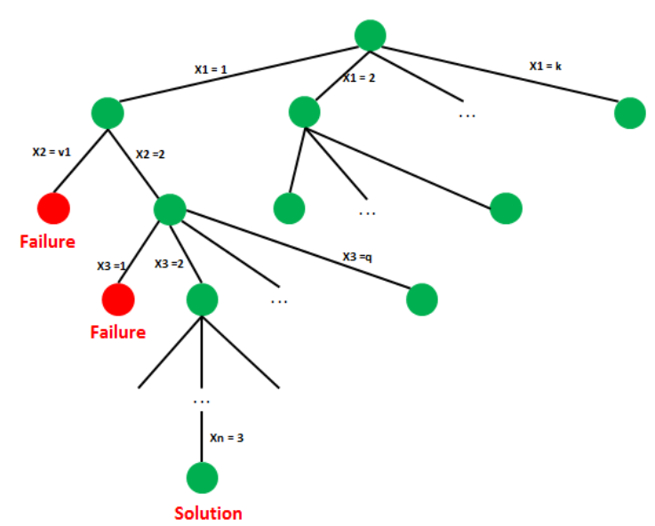
Branching and Backtracking Search

Slide 21
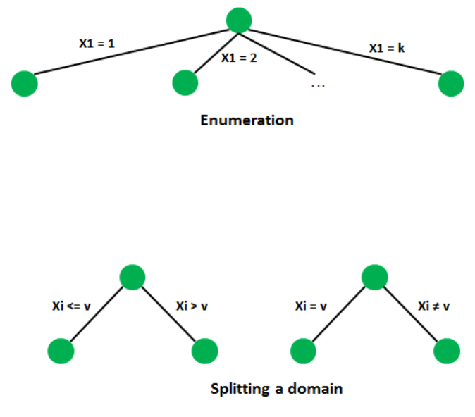
Branching and Backtracking Search

Slide 22
Branching and Backtracking Search
Search strategies
Variable selection
dom heuristic: select a variable having the smallest domain
deg heuristic: select a variable participating in most of the constraints
dom+deg heuristic: first apply dom, then use deg when tie break (when there are more than one variable with the same smallest domain size)
dom/deg: select a variable having the smallest dom/deg
Value selection
Increasing order
Decreasing order

Slide 23
Example
Variables
X = {X₀, X₁, X₂, X₃, X₄}
Domain
X₀, X₁, X₂, X₃, X₄ ∈ {1,2,3,4,5}
Constraints
C₁: X₂ + 3 ≠ X₁
C₂: X₃ ≤ X₄
C₃: X₂ + X₃ = X₀ + 1
C₄: X₄ ≤ 3
C₅: X₁ + X₄ = 7
C₆: X₂ = 1 ⇒ X₄ ≠ 2

Slide 24
Example
' ‘ ‘
If-Then-Else expression
if x[2] = 1 then x[4] != 2
'''
from ortools.sat.python import cp_model
class VarArraySolutionPrinter(cp_model.CpSolverSolutionCallback):
#print intermediate solution
def __init__(self,variables):
cp_model.CpSolverSolutionCallback.__init__(self)
self.__variables = variables
self.__solution_count = 0
def on_solution_callback(self):
self.__solution_count += 1
for v in self.__variables:
print('%s = %i'% (v,self.Value(v)), end = ' ')
print()
def solution_count():
return self.__solution_count

Slide 25
Example
model = cp_model.CpModel()
x = {}
for i in range(5):
x[i] = model.NewIntVar(1,5,'x[' + str(i) + ']')
c1 = model.Add(x[2] + 3 != x[1])
c2 = model.Add(x[3] <= x[4])
c3 = model.Add(x[2] + x[3] == x[0] + 1)
c4 = model.Add(x[4] <= 3)
c5 = model.Add(x[1] + x[4] == 7)
b = model.NewBoolVar('b')
#constraints
model.Add(x[2] == 1).OnlyEnforceIf(b)
model.Add(x[2] != 1).OnlyEnforceIf(b.Not())
model.Add(x[4] != 2).OnlyEnforceIf(b)

Slide 26
Example
solver = cp_model.CpSolver()
#Force the solver to follow the decision strategy exactly
solver.parameters.search_branching = cp_model.FIXED_SEARCH
vars = [x[i] for i in range(5)]
solution_printer = VarArraySolutionPrinter(vars)
solver.SearchForAllSolutions(model,solution_printer)

